Slide 1
ARM7TDMI - REVIEW 4
Course Code - 22EECP204
Team: 3 Division: ‘B’
Name USN
Amit Kumar 01fe22bec045
Nidhi Neje 01fe22bec049
Sejal Ankush 01fe22bec051
Sakshi Kulkarni 01fe22bec058

Slide 2
PROBLEM STATEMENT :
Build an application to demonstrate the use of I2C protocol and PIR sensor with necessary
assumptions.

Slide 3
Introduction:
To develop a car parking system that detects a car entering the parking lot with the help of a PIR sensor and displays it on an LCD. The system allows a maximum of 10 cars to enter a floor and displays the status on the UART. When the count exceeds 10, the parking lot becomes full, which is indicated using LED lights and is also displayed on the UART.

Slide 4
Peripherals used:
PIR Sensor: Detects the presence of a car.
UART: Used for communication.
LED: Indicates the status of the parking lot.
LCD: Displays messages related to parking status.

Slide 5
Block Diagram:
UART
LPC2148
PIR SENSOR
LED

Slide 6
CODE:
#include <lpc214x.h>
#include <stdlib.h>
#include <string.h>
#define SLAVE_ADDR 0x4E
#define MAX 10
#define AA 2
#define SI 3
#define STO 4
#define STA 5
#define I2EN 6
#define PIR (IOPIN1 & (1 << 24))
unsigned int count = 0;
char string[35] = "INTRUDER DETECTED";
char string1[35] = "The vehicle is parked.\n";
char string2[35] = "The parking lot is full\n";

Slide 7
void wait(int count);
void serial_init() {
PINSEL0 |= 0x00000005;
U0LCR = 0x83;
U0DLL = 0x61;
U0DLM = 0x00;
U0LCR = 0x03; // DLAB = 0
}
void transmit(const char *str) {
IOSET0 = 0XFFFFFFFF;
wait(2000);
IOCLR0 = 0XFFFFFFFF;
while (*str) {
while (!(U0LSR & (1 << 5))); // Wait until the THR is empty
U0THR = *str++;
}
while (!(U0LSR & (1 << 5))); // Wait until the THR is empty
U0THR = '\n'; // Send newline character
}
void wait(int count) {
int tmp = count;
while (tmp--);
}
CODE:

Slide 8
CODE:
void I2C_Init(void) {
PINSEL0 |= 0x00000050; // Set P0.2 and P0.3 to SDA and SCL
I2C0SCLH = 0x18; // 50% duty cycle, I2CFreq = 100KHz, PCLK = 30MHz
I2C0SCLL = 0x12;
I2C0CONSET = (1 << I2EN); // Enable I2C module
}
void I2C_Start() {
I2C0CONCLR = 1 << STO;
I2C0CONCLR = 1 << SI;
I2C0CONSET = 1 << STA;
while (!(I2C0CONSET & (1 << SI))); // Wait for SI to set
}
void I2C_Stop() {
I2C0CONSET = 1 << STO;
I2C0CONCLR = 1 << SI | 1 << STA;
}

Slide 9
CODE:
void I2C_Write(char data) {
I2C0DAT = data;
I2C0CONCLR = 1 << SI;
while (!(I2C0CONSET & (1 << SI))); // Wait for SI to set
}
void LCD_Command(char cmnd) {
I2C_Start();
I2C_Write(SLAVE_ADDR); // SLA+W
I2C_Write((cmnd & 0xF0) | 0x04); // Send upper nibble
I2C_Write((cmnd & 0xF0)); // Clear upper nibble
I2C_Write((cmnd << 4) | 0x04); // Send lower nibble
I2C_Write((cmnd << 4)); // Clear lower nibble
I2C_Stop();
wait(2000); // Wait for the command to process
}

Slide 10
void LCD_Char(char char_data) {
I2C_Start();
I2C_Write(SLAVE_ADDR); // SLA+W
I2C_Write((char_data & 0xF0) | 0x05); // Send upper nibble
I2C_Write((char_data & 0xF0) | 0x01); // Clear upper nibble
I2C_Write((char_data << 4) | 0x05); // Send lower nibble
I2C_Write((char_data << 4) | 0x01); // Clear lower nibble
I2C_Stop();
wait(2000); // Wait for the character to process
}
void LCD_String(char *str) {
while (*str != '\0') {
LCD_Char(*str++);
}
}
void LCD_Init() {
I2C_Init();
LCD_Command(0x02); // Initialize LCD in 4-bit mode
LCD_Command(0x28); // 2 lines, 5x7 matrix
LCD_Command(0x0C); // Display on, cursor off
LCD_Command(0x06); // Increment cursor
LCD_Command(0x01); // Clear display
wait(2000); // Wait for the initialization to complete
}
CODE:

Slide 11
void LCD_Clear() {
LCD_Command(0x01); // Clear display
wait(2000); // Wait for the clear command to process
}
int main() {
serial_init();
IODIR0 = 0x000F0FFF; // Set lower 12 bits of PORT0 as output (for the LCD)
IODIR1 = 0x00000000; // Set PORT1 as input (for the PIR sensor)
LCD_Init(); // Initialize LCD
while (1) {
if (count < MAX) {
if (PIR == 0) { // PIR sensor detects obstacle
transmit(string1);
count++;
LCD_Clear();
LCD_String(string);
IOPIN1 = (1 << 24); // Just setting the input pin as an example (Not recommended)
} else { // No obstacle detected
LCD_Clear();
}
CODE:

Slide 12
Code:
wait(2000000); // Short delay to debounce the sensor
}
else
{ transmit(string2);
IOSET0 = 0x000F0000; // Turn on buzzer
wait(400000);
IOCLR0 = 0x000F0000; // Turn off buzzer
wait(400000);
}
}
}

Slide 13
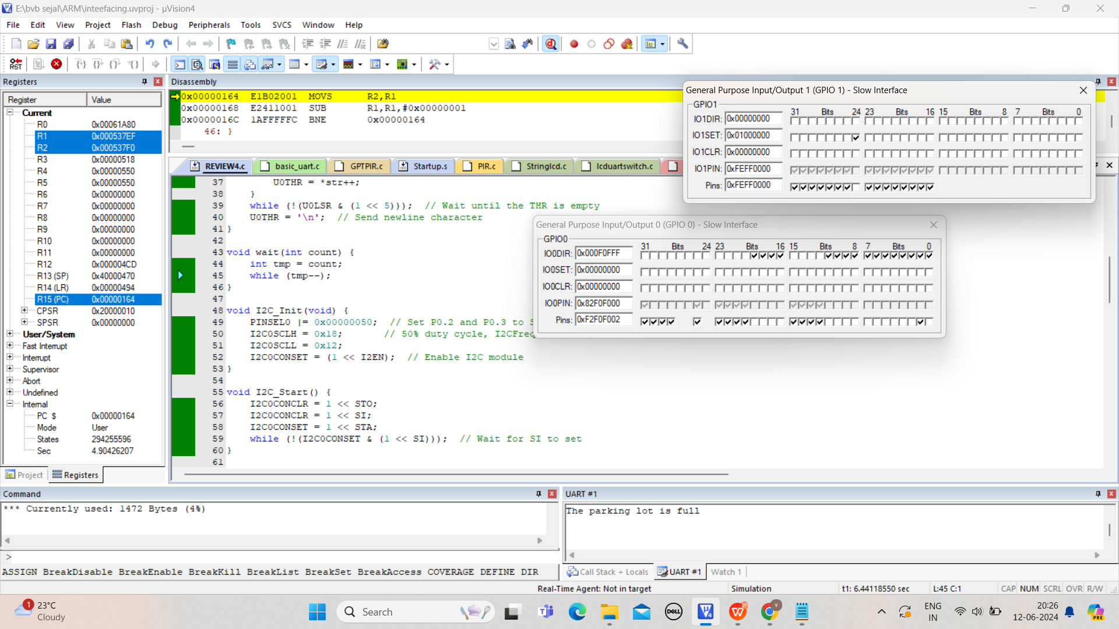
SIMULATION:

Slide 15
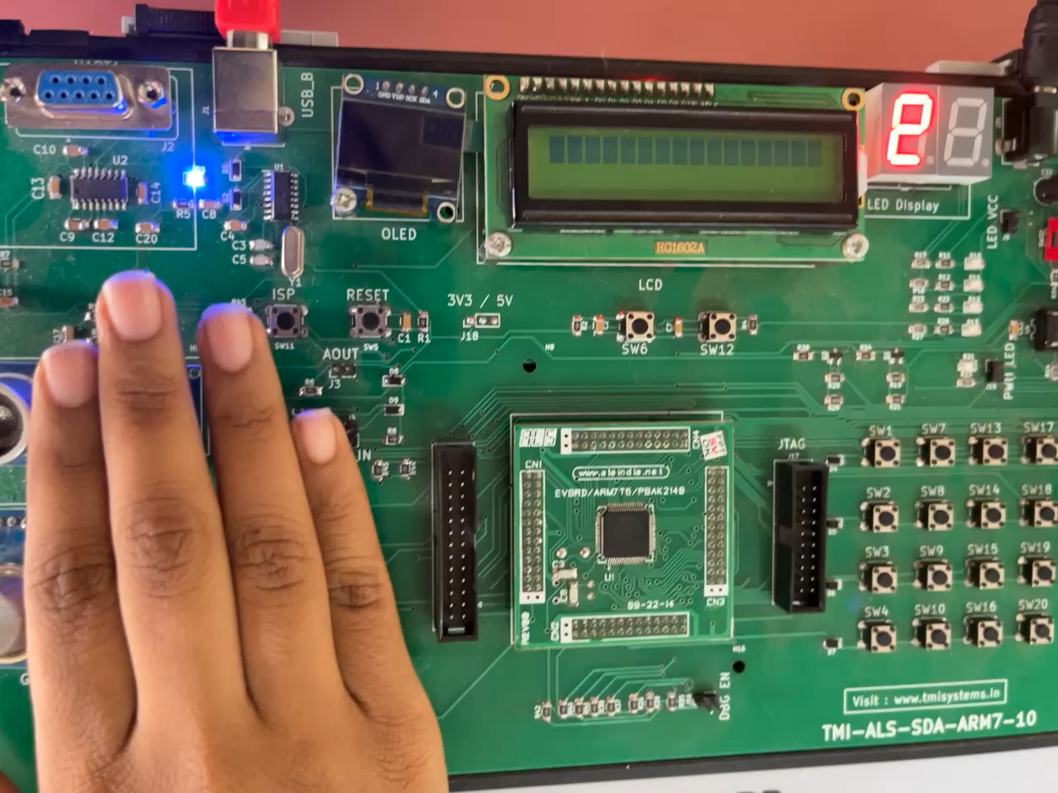

Slide 16
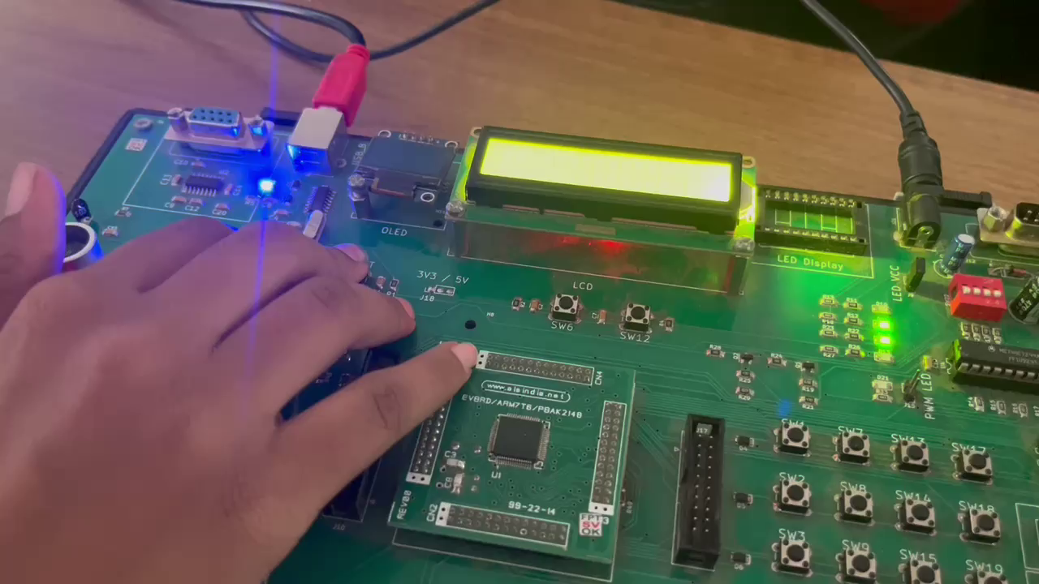

Slide 17
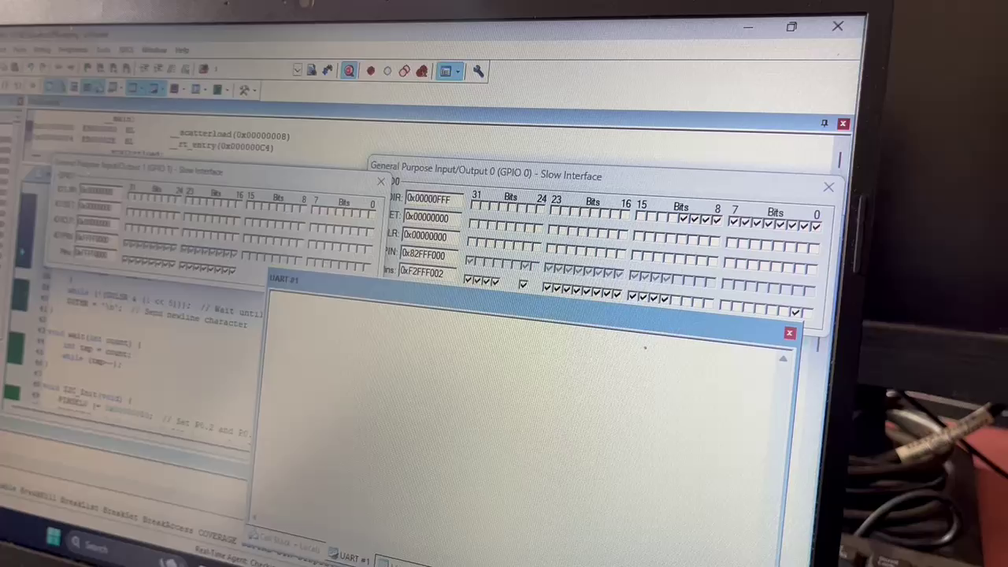

Slide 18
Key Points
Purpose:
The code manages a simple parking lot monitoring system with an LCD display and UART communication.
PIR Sensor:
Used to detect vehicles entering the parking lot.
LCD:
Displays messages based on the sensor input.
UART:
Sends status messages.

Slide 19
Thank you

